Slide 1


Slide 2


Slide 3
A : B = 5 : 7 and B : C = 6 : 11, then
A : B : C is :
(a) 55 : 77: 66 (b) 30: 42: 77
(c) 35 : 49 : 42 (d) none of these

Slide 4
If A : B = 8 : 15, B : C = 5 : 8
and C : D = 4 : 5, then A: D is
equal to :
(a) 2 : 7 (b) 4 : 15
(c) 8 : 15 (d) 15 : 4

Slide 5
Find the value of a : b : c : d,
if a : b = 2 : 3, b : c = 4 : 5
and c : d = 6 : 7.
(a) 16 : 24 : 30 : 35 (b) 18 : 22 : 30 : 35
(c) 16 : 24 : 30 : 36 (d) 18 : 22 : 35 : 30

Slide 6
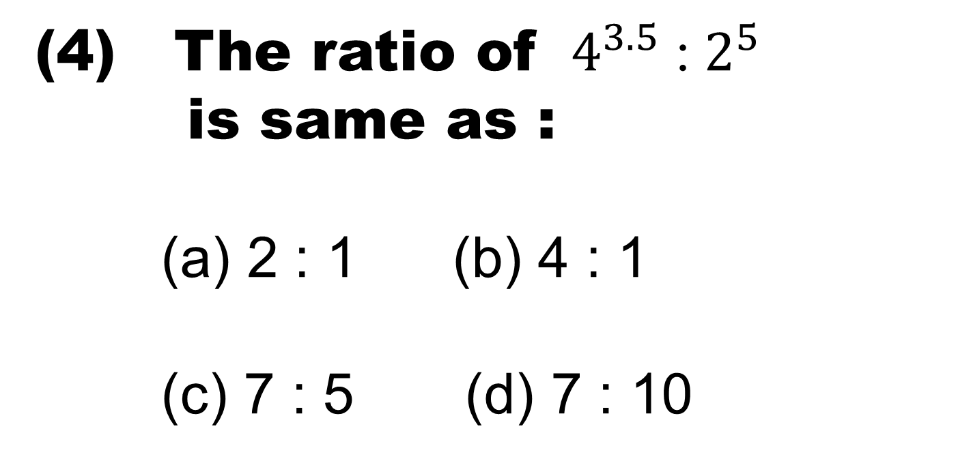
(4) The ratio of ${ 4}^{3.5}$ : $2^{5}$
is same as :
(a) 2 : 1 (b) 4 : 1
(c) 7 : 5 (d) 7 : 10

Slide 7
If 15% of x = 20 % of y , then
x:y is :
(a) 3 : 4 (b) 4 : 3
(c ) 17 : 16 (d) 16 : 17

Slide 8
If (a +b) : (b + c) : ( c + a) =
6 : 7 : 8 and ( a + b + c ) = 14
then the value of c is :
(a) 6 (b) 7
(c) 8 (d) 14

Slide 9
Two numbers are in the ratio
3 : 5. If 9 is subtracted from
each, the new numbers are in
the ratio 12 : 23 . The smaller
number is :
(a) 27 (b) 33
(c) 49 (d) 55

Slide 10
In a bag , there are coins of 25 p ,
10 p and 5 p in the ratio of 1: 2: 3 .
If there are Rs.30 in all , how many 5 p
coins are there ?
(a) 50 (b) 100
(c) 150 (d) 200

Slide 11
(9) The ratio of three numbers is
3 : 4 : 5 and the sum of their
squares is 1250. The sum of
the numbers is:
(a) 30 (b) 50
(c) 60 (d) 90

Slide 12
The sum of three numbers is 98 .
If the ratio of the first to the
second is 2 : 3 and that of the
second to third is 5 : 8 , than
second number is:
(a) 20 (b) 30
(c) 48 (d) 58

Slide 13
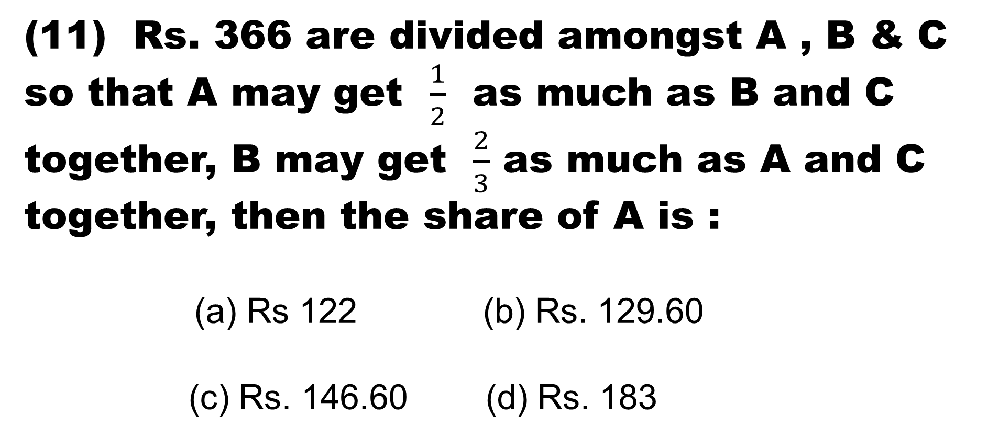
(11) Rs. 366 are divided amongst A , B & C so that A may get $\frac{1}{2}$ as much as B and C together, B may get $\frac{2}{3}$ as much as A and C together, then the share of A is :
(a) Rs 122 (b) Rs. 129.60
(c) Rs. 146.60 (d) Rs. 183

Slide 14
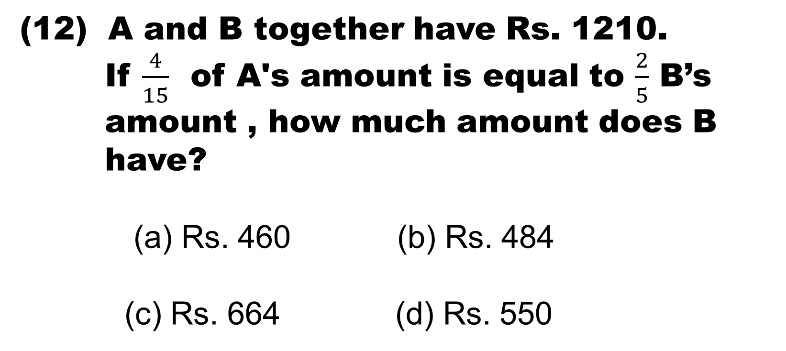
(12) A and B together have Rs. 1210.
If $\frac{4}{15}$ of A's amount is equal to $\frac{2}{5}$ B’s
amount , how much amount does B
have?
(a) Rs. 460 (b) Rs. 484
(c) Rs. 664 (d) Rs. 550

Slide 15
(13) Two numbers are respectively
20% and 50% more than a third
number. The ratio of the two
numbers is:
(a) 2 : 5 (b) 3 : 5
(c) 4 : 5 (d) 6 : 7

Slide 16
(14) Seats for Mathematics, Physics and Biology in a school are in the ratio 5 : 7 : 8 .
There is a proposal to increase these seats by 40%, 50% and 75% respectively. What will be the ratio of increased seats ?
(a) 2 : 3 : 4 (b) 6 : 7 : 8
(c) 6 : 8 : 9 (d) none of these

Slide 17
The fourth proportional to
5, 8, 15 Is :
(a) 18 (b) 24
(c) 19 (d) 21

Slide 18
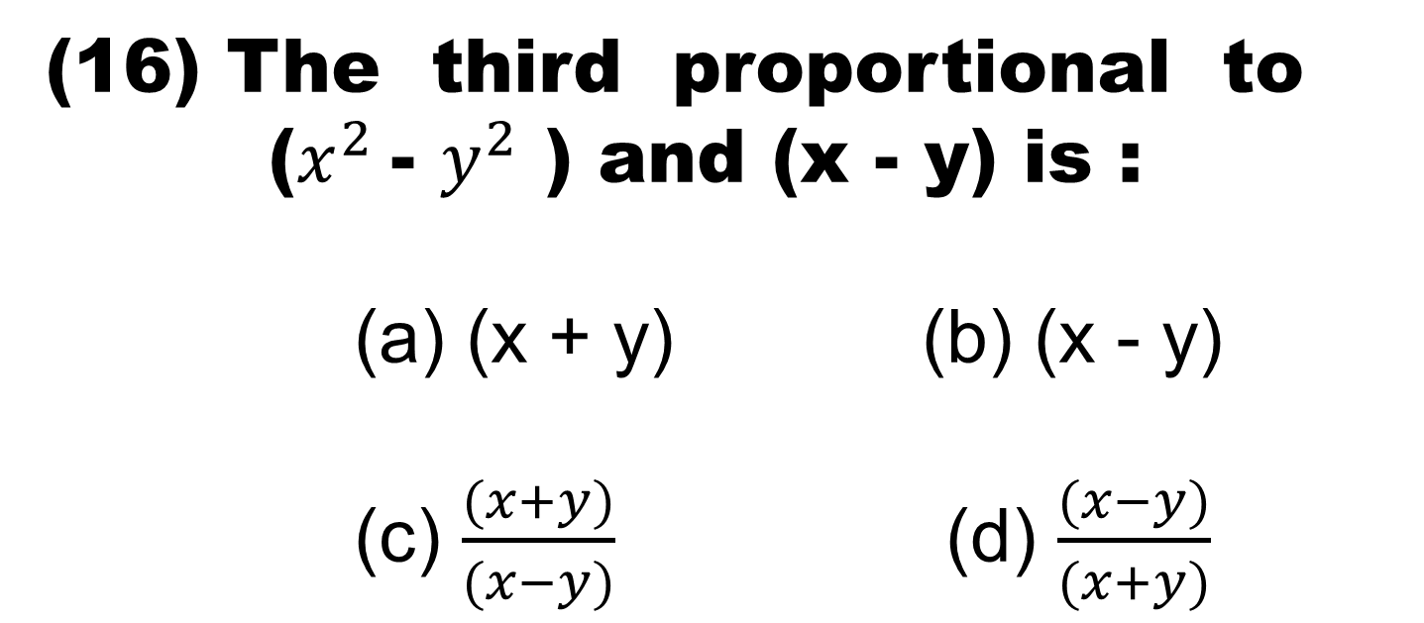
(16) The third proportional to
($x^{2}$- $y^{2}$ ) and (x - y) is :
(a) (x + y) (b) (x - y)
(c) $\frac{(x+y)}{(x−y)}$ (d) $\frac{(x−y)}{(x+y)}$

Slide 19
An amount of Rs. 735 was divided
between A, B and C. If each of them
had received Rs. 25 less, their
shares would have been in the ratio
of 1 : 3 : 2. The money received by C
was:
(a) Rs. 195 (b) Rs. 200
(c) Rs. 225 (d) Rs. 245

Slide 20
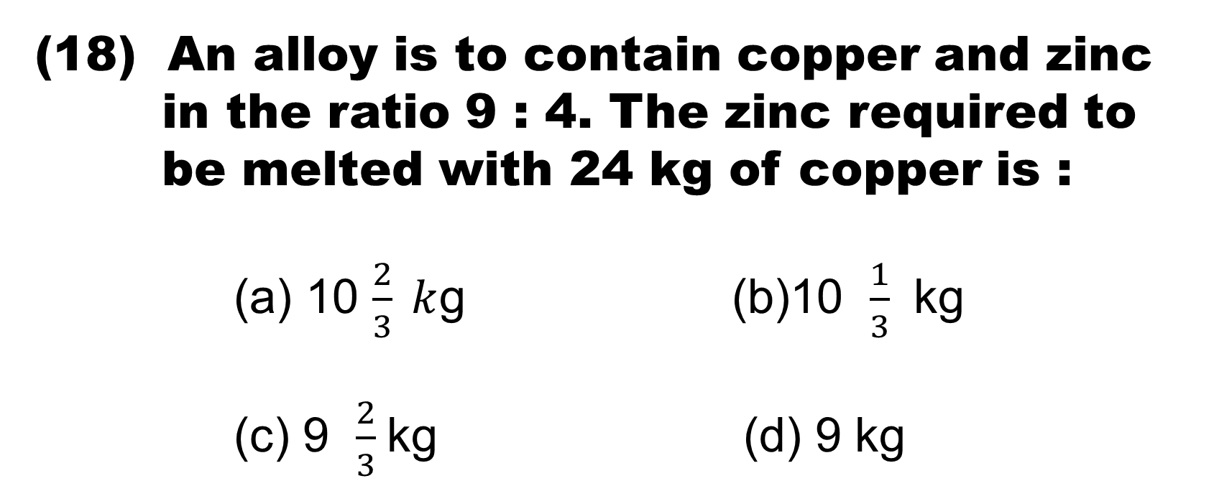
An alloy is to contain copper and zinc
in the ratio 9 : 4. The zinc required to
be melted with 24 kg of copper is :
(a) 10 $\frac{2}{3} k$g (b)10 $\frac{1}{3}$ kg
(c) 9 $\frac{2}{3}$kg (d) 9 kg

Slide 21
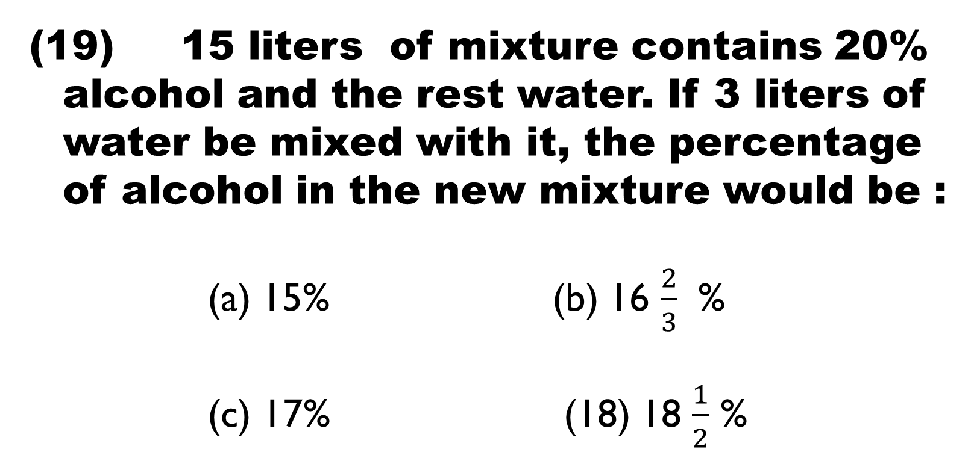
15 liters of mixture contains 20% alcohol and the rest water. If 3 liters of water be mixed with it, the percentage of alcohol in the new mixture would be :
(a) 15% (b) 16 $\frac{2}{3}$ %
(c) 17% (18) 18 $\frac{1}{2}$ %

Slide 22
85 kg of a mixture contains milk and water in the ratio 27 : 7. How much more water is to be added to get a new mixture containing milk and water in the ratio 3:1 ?
(a) 5 kg (b) 8 kg
(c) 6.5 kg (d) 7.25 kg

Slide 23
(21) The speeds of three cars are in the ratio 5 : 4 : 6. The ratio between the time taken by them to travel the same distance is :
(a) 5 : 4 : 6 (b) 6 : 4 : 5
(c) 10 : 12 : 15 (d) 12 : 15 : 10

Slide 24
In a college, the ratio of the number of
boys to girls is 8 : 5. If there are 160
girls , the total number of students in
the college is :
(a) 100 (b) 250
(c) 260 (d) 416

Slide 25
(23) The ratio of the number of boys and girls in a school is 3 : 2. If 20% of the boys and 25% of the girls are scholarship holders, what percentage of the students does not get the scholarship?
(a) 56 (b) 70
(c) 78 (d) 80

Slide 26
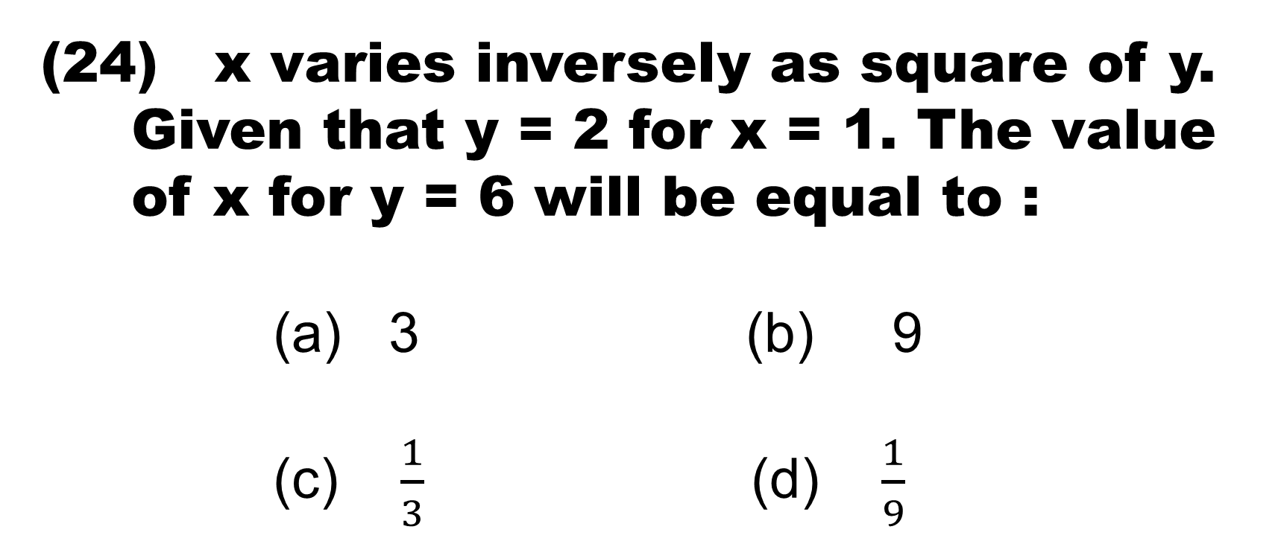
x varies inversely as square of y. Given that y = 2 for x = 1. The value of x for y = 6 will be equal to :
(a) 3 (b) 9
(c) $\frac{1}{3}$ (d) $\frac{1}{9}$

Slide 27
(25) If 10% of x = 20% of y , then x : y
is equal to :
(a) 1 : 2 (b) 2 : 1
(c) 5 : 1 (d) 10 : 1

Slide 28
(26) A sum of Rs. 53 is divided among A, B, C in such a way that A gets Rs. 7 more than what B gets and B gets Rs. 8 more than what C gets. The ratio of their shares is:
(a) 16 : 9 : 18 (b) 25 : 18 : 10
(c) 18 : 25 : 10 (d) 15 : 8 : 30

Slide 29
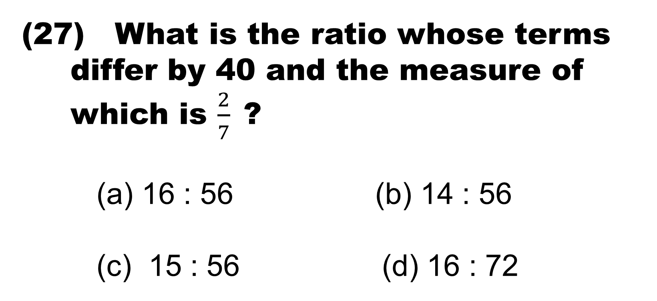
What is the ratio whose terms differ by 40 and the measure of which is $\frac{2}{7}$?
(a) 16 : 56 (b) 14 : 56
(c) 15 : 56 (d) 16 : 72

Slide 30


